Slide 1
Software Construction Laboratory CS35L – Lab 1
Course Webpage: https://web.cs.ucla.edu/classes/fall18/cs35L/index.html
TA: Zhiyi Zhang
Email: zhiyi@cs.ucla.edu
Webpage: https://zhiyi-zhang.com

Slide 2
Session 4-2
Brief introduction to Public Key Cryptography
Debugging in C
Programming in C for homework 4

Slide 3
Brief introduction to Public Key Cryptography

Slide 4
Public Key Cryptography
Cryptographic system that uses pairs of keys
public keys which may be disseminated widely
private keys which are known only to the owner
Examples
Cryptography Schemes: RSA (Rivest–Shamir–Adleman), ECC (Elliptic-curve cryptography), Attribute-based Encryption, etc.
Well-known use case: HTTPS, TLS, SSH, etc.
Notes:
integer factorization, discrete logarithm

Slide 5
Public Key Cryptography
Digital Signature
Presenting the authenticity of digital messages or documents
Generated by the private key
Verified by the public key
Public Key Encryption
Use one key from a pair for encryption
Use another key from a pair for decryption

Slide 6
An simple example of Digital Signature
Alice knows Bob’s public key
Bob uses his private key to generate a signature for a message
Alice use Bob’s public key to verify the signature
If valid: the signature is truly generated by Bob and has not been modified
If invalid: the signature is not generated by Bob or the content has been modified (e.g., Man in the Middle attack)

Slide 7
An simple example of Public Key Encryption
Alice knows Bob’s public key
Alice uses Bob’s public key to encrypt the message
Bob use his private key to decrypt the message

Slide 8
Debugging in C

Slide 9
Debugging
Finding and eliminating errors from programs
Grace Hopper and the “First actual case of bug being found”
Process:
Find/Reproduce the bug
Simplify program input
Use a debugger to track down the origin of the problem
Fix the problem

Slide 10
Debugger
A program that is used to run and debug other (target) programs
With a debugger, programmers can:
step through source code line by line
each line is executed on demand
interact with and inspect program at run-time
If program crashes, the debugger outputs where and why it crashed

Slide 11
GDB – GNU Debugger
Debugger for several languages
C, C++, Java, Objective-C, etc
Allows you to inspect what the program is doing at a certain point (breakpoint) during execution
Logical errors and segmentation faults are easier to ﬁnd with the help of gdb

Slide 12
How to use GDB
Compile Program
Without a debugger: gcc [flags] <source files> -o <output file>
Check our previous slides (week 3) if you forgot this :D
With gdb: gcc [other flags] –g <source files> -o <output file>
Produce debugging information that can be used by built-in debugger
Specify Program to Debug
Use gdb command with argument: “gdb <executable>”
Specify program in gdb: “gdb” and then “(gdb) file <executable>”

Slide 13
How to use GDB
Run your program
(gdb) run
(gdb) run [arguments]
When you are in GDB’s interactive shell
Tab to autocomplete, up-down arrow to recall history commands
help [command] to get help information of a command
Exit
(gdb) quit

Slide 14
Find out bugs
Common bugs
Segmentation fault (program stopped unexpectedly)
Logic error (program exits successfully)
Use Breakpoints to find out bugs
used to stop the running program at a specific point
prompt you for another command to move on

Slide 15
How to use breakpoints
Setting breakpoints
(gdb) break file1.c:6
(gdb) break my_function
(gdb) break [position] if [expression]
Check the existing breakpoints
(gdb) info breakpoints
Or break or br or b

Slide 16
How to use breakpoints
Delete breakpoints
(gdb) delete [breakpoint_id]
Enable/Disable breakpoints
(gdb) disable/enable [breakpoint_id]
Ignore breakpoints for several times
(gdb) ignore [break_point_id] [iterations]

Slide 17
More commands when using GDB
Printing data of interest at run time
(gdb) print [format] [expression]
d, x, o, t for decimal, hexadecimal, octal, and binary notation
Watch changes to variables
(gdb) watch [var_name]
(gdb) rwatch [expression]
When a program stops at a breakpoint
(gdb) continue | step | next | finish
c or continue: debugger will continue executing until next breakpoint.
s or step: debugger will continue to next source line.
n or next: debugger will continue to next source line in the current (innermost) stack frame.
f or finish: debugger will resume execution until the current function returns. Execution stops immediately after the program flow returns to the function's caller
Notes:
The watch command sets a watchpoint on var_name. the debugger will stop the program when the value of var_name changes: both old and new values will be printed.
The debugger stops the program whenever the program reads the value of any object involved in the evaluation of expression

Slide 18
More commands when using GDB
List all functions in the program
(gdb) info functions
List the source code lines around the current line
(gdb) list

Slide 19
Brief Introduction to Process Memory
Stack
Push frame when function invoked
Pop frame when function returned
Stores local vars, return address, etc.
Heap
Dynamic memory allocation

Slide 20
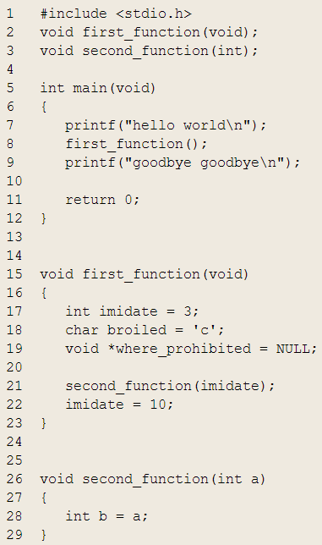
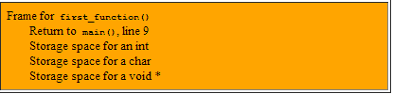
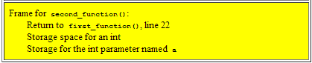
Stack Frames and the Stack
Program Ends
When first_function() returns, its frame is used to determine where to return to (line 9 of main()), then deallocated and returned to the stack
Call to second_function() is made, unused stack memory is used to create a stack frame for second_function(). The frame holds 3 things: storage space for an int and the current address of execution within second_function()
One stack frame belonging to main():
Uninteresting since main() has no automatic variables, no parameters, and no function to return to
Call to first_function() is made, unused stack memory is used to create a frame for first_function(). It holds four things: storage space for an int, a char, and a void *, and the line to return to within main()
When second_function() returns, its frame is used to determine where to return to (line 22 of first_function()), then deallocated and returned to stack.
When main() returns, the program ends

Slide 21
FYI: Analyzing the stack
(gdb) info frame
Displays information about the current stack frame, including its return address and saved register values
(gdb) info locals
Lists the local variables of the function corresponding to the stack frame, with their current values
(gdb) info args
List the argument values of the corresponding function call

Slide 22
Programming in C for you Homework 4

Slide 23
Data types, pointers, struct
Basic data type
int
float
double
char
void
Pointers
<variable_type> *<name>
Struct
struct <name> { ... }

Slide 24
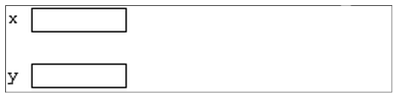
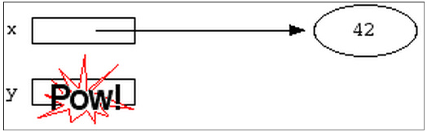
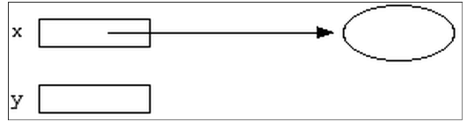
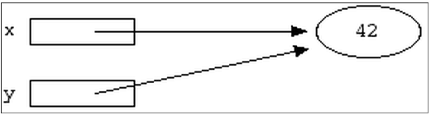
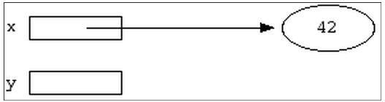
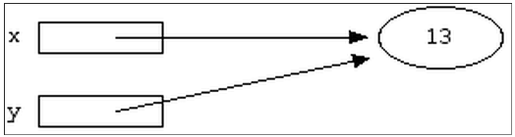
Pointer Example
int *x;
int *y;
*y = 13;
int var;
x = &var;
y = x;
*x = 42;
*x = 13;

Slide 25
Dynamic Memory Allocation
void *malloc (size_t size);
Allocates size bytes and returns a pointer to the allocated memory
void *realloc (void *ptr, size_t size);
Changes the size of the memory block pointed to by ptr to size bytes
void free (void *ptr);
Frees the block of memory pointed to by ptr

